Slide 1



LARANA, INC.

Slide 2


Slide 3
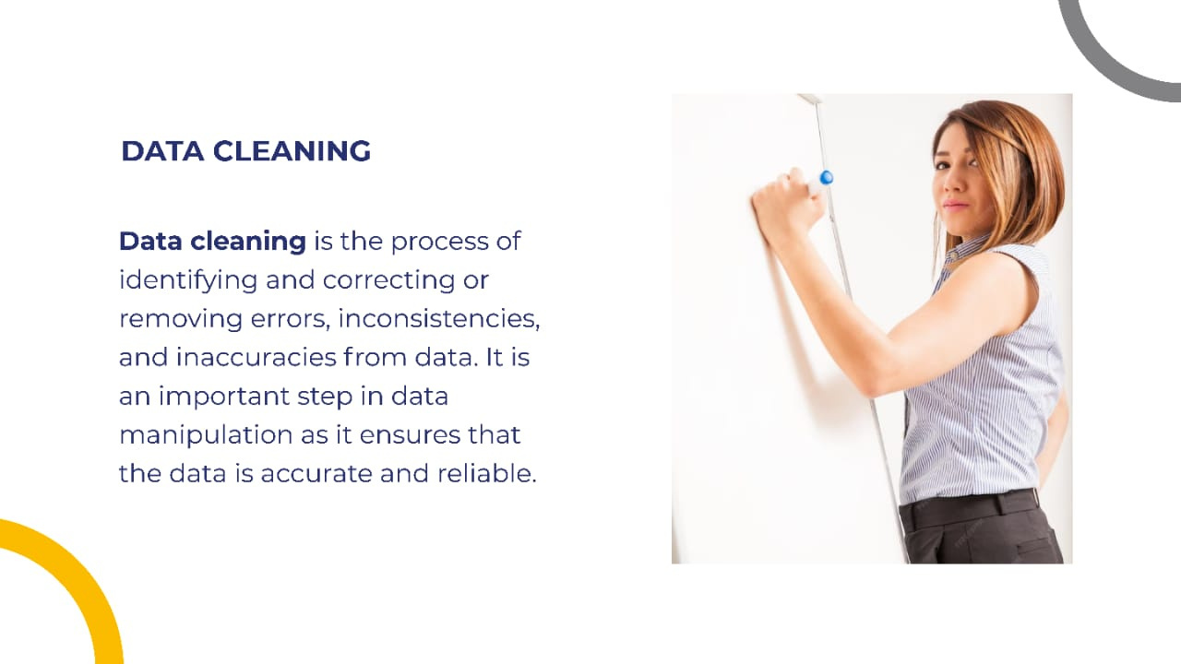

Slide 4
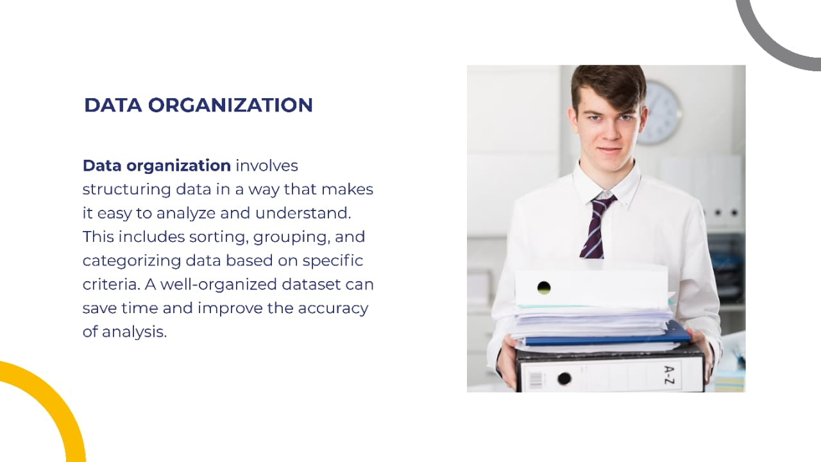

Slide 5



Slide 6

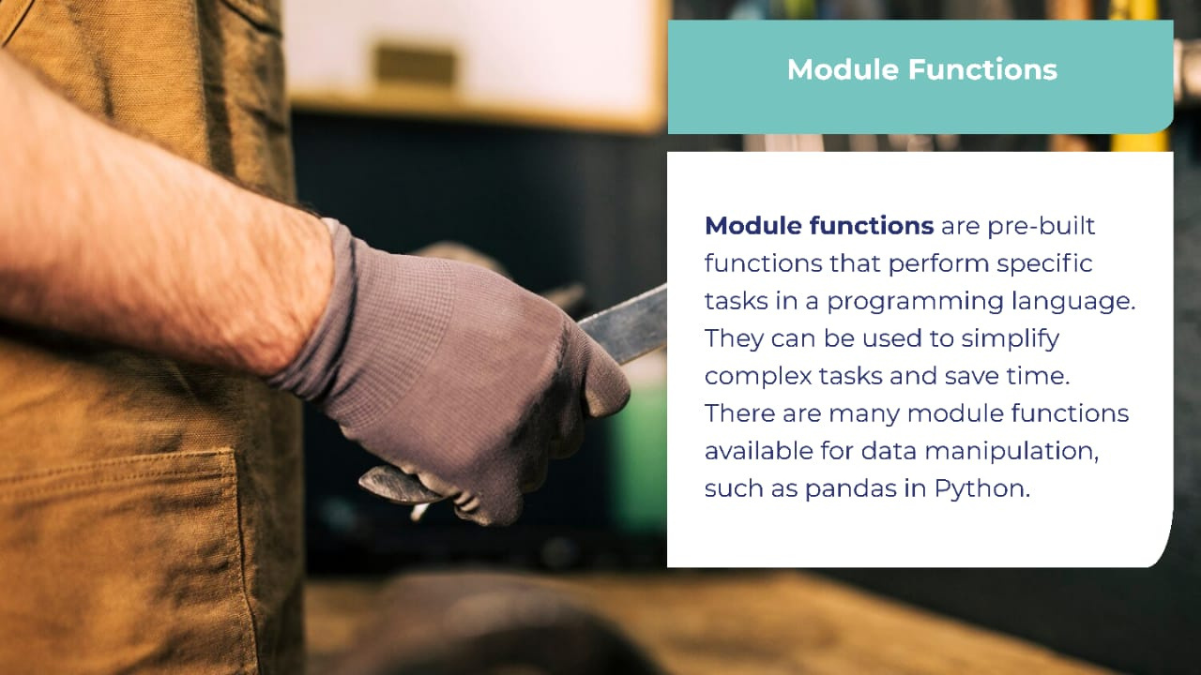


Slide 7
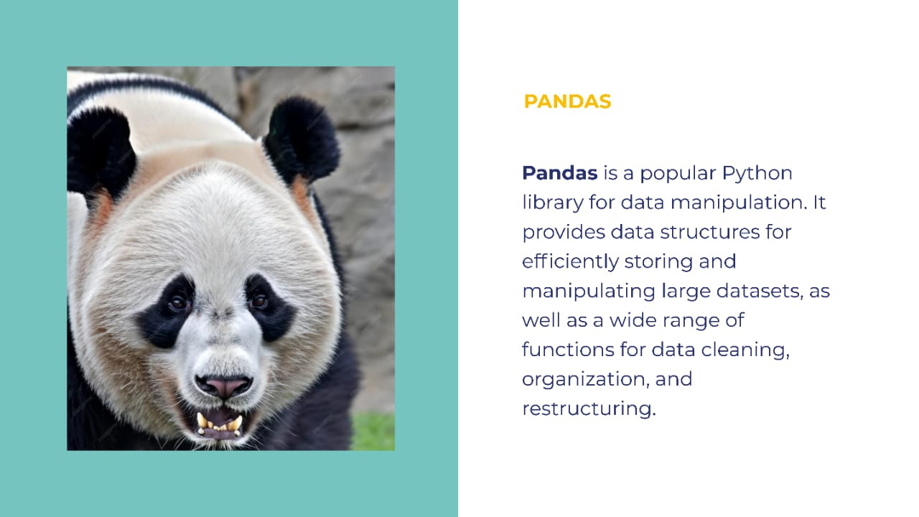


Slide 8


Slide 9


Slide 10


Slide 11
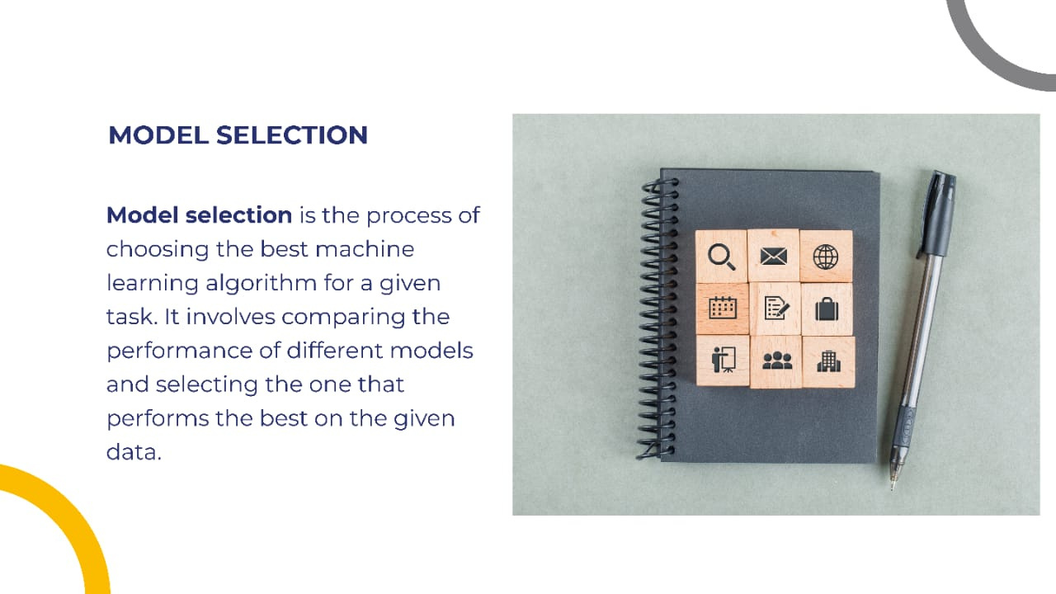

Slide 12



Slide 13


Slide 14


